Slide 1
Method of Sections
Dr. Jacob Moore
Associate Professor of Engineering
Penn State Mont Alto

Slide 2
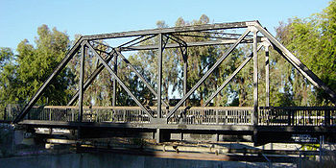
Method of Sections
The Method of Sections is a process used to solve for the forces acting on individual members in a truss.
A truss is a type of engineering structure where all the members in the structure are two force members.
As part of this assumption, all external forces must be supported at the joints

Slide 3
The Method of Sections
The method of sections works on the following assumptions:
The structure you are analyzing is in static equilibrium.
If the structure were to be cut into sections, each of those sections would also be in equilibrium.
When you cut through a member in a structure, you “expose” the internal forces in that member.

Slide 4
Method of Sections
Step 1: Assign letters to all the joints and identify the members by the two joints they connect.
(applies to method of joints and method of sections.)
80 kN
60 kN
10 m
10 m
10 m
Y
A
B
D
F
X
20°
C
E

Slide 5
Method of Sections
Step 2 (Optional): Treat the whole truss structure as a rigid body and solve for the external reaction forces
Draw a free body diagram of the truss as a whole.
Write out the equilibrium equations (sum of forces in the x, sum of forces in the y, and sum of moments).
Solve the equations for the unknown reaction forces.
80 kN
F_{FY}
F_{AY}
60 kN
10 m
10 m
10 m
Y
A
F_{AX}
B
D
F
X
20°
C
E

Slide 6
Method of Sections
Step 3: Imagine cutting the truss into two sections.
Cut through members (no joints) that you need to find the forces in.
Try to not cut more than 3 members for 2D problems or 6 members for 3D problems.
80 kN
73.3 kN
66.7 kN
60 kN
10 m
10 m
10 m
Y
A
B
D
F
X
20°
C
E

Slide 7
Method of Sections
Step 4: Draw one of the two halves separately and add in the internal forces from each cut member
Assume tension, negative answers will indicate compressive forces in members.
73.3 kN
66.7 kN
60 kN
10 m
10 m
Y
A
B
D
F
F_{BD}
X
20°
F_{BE}
F_{CE}
C
E

Slide 8

Method of Sections
Step 5: Write out the equations of equilibrium (forces in the x, forces in the y, and moments)
Step 6: Solve the equations.
73.3 kN
66.7 kN
60 kN
$$\sum{F_{x}}=0$$
$$\sum{F_{y}}=0$$
$$\sum{M}=0$$
10 m
10 m
Y
A
B
D
F
F_{BD}
X
20°
F_{BE}
F_{CE}
C
E

Slide 9
Extending the Method of Sections
Sometimes we are asked to find the forces acting in specific members, but no one cut with the method of sections will give us all the forces we are looking for.
For example, imagine we were asked to find the forces in members AC, BC, CD, and CE.
10 m
10 m
10 m
6 m
6 m
E
F
15° x2
6 m
40 kN
C
D
50 kN
6 m
A
B

Slide 10
Extending the Method of Sections
In cases such as this, the best approach may be to...
Use the Method of Sections twice
Use the Method of Sections and then the Method of Joints.
10 m
10 m
10 m
6 m
6 m
E
F
15° x2
6 m
40 kN
C
D
50 kN
6 m
A
B

Slide 11
Using the Method of Sections Repeatedly
If one round of the Method of Sections will not allow you to solve for all the unknowns, you can employ the method of sections repeatedly:
Use the Method of Sections once to solve for one or more unknown forces. You will want to cut through no more than three members (getting three unknowns for your three equations).
Once you have solved for those unknowns, use an alternate cut with the Method of Sections again to solve for different unknowns.
Any members you have already solved for do not count towards the “three unknowns” limit

Slide 12
Using the Method of Sections Repeatedly
Find the forces acting in the members AC, BC, CD, and CE
10 m
10 m
10 m
6 m
6 m
E
F
6 m
40 kN
C
D
50 kN
6 m
A
B

Slide 13
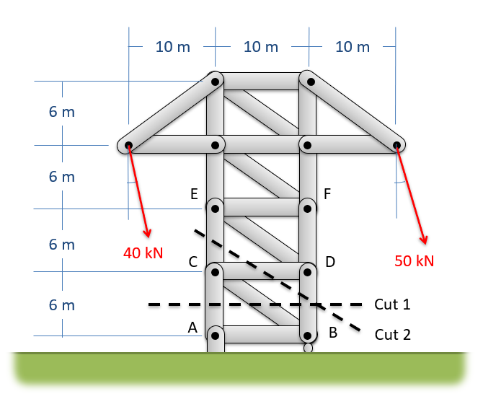
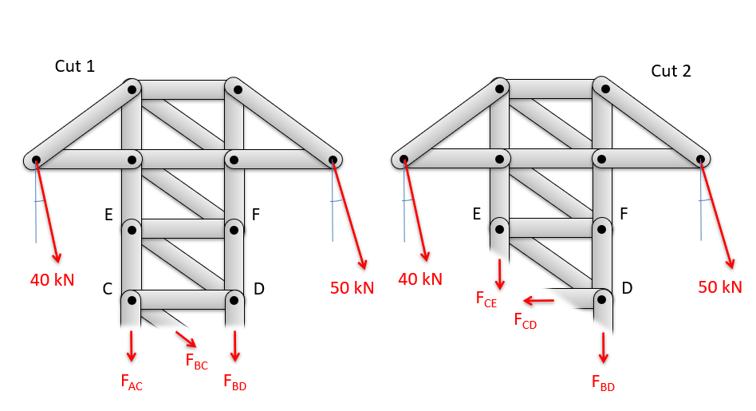

Slide 14
Using the Method of Sections and then the Method of Joints
If one round of the Method of Sections will not allow you to solve for all the unknowns, you can employ the method of sections to start then switch to the method of joints:
Use the Method of Sections once to solve for one or more unknown forces. You will want to cut through no more than three members (getting three unknowns for your three equations).
Once you have solved for those unknowns, analyze a joint near the cut from the previous step. You will analyze that joint just as you did in any Method of Joints problem
You will want to look at a joint with no more than two unknown forces acting on it.

Slide 15
Combining Methods Worked Example
Find the forces acting in the members AC, BC, CD, and CE
10 m
10 m
10 m
6 m
6 m
E
F
6 m
40 kN
C
D
50 kN
6 m
A
B

Slide 16
Combining Methods Worked Example
10 m
10 m
10 m
6 m
6 m
E
F
6 m
40 kN
C
D
50 kN
6 m
A
B

Slide 17
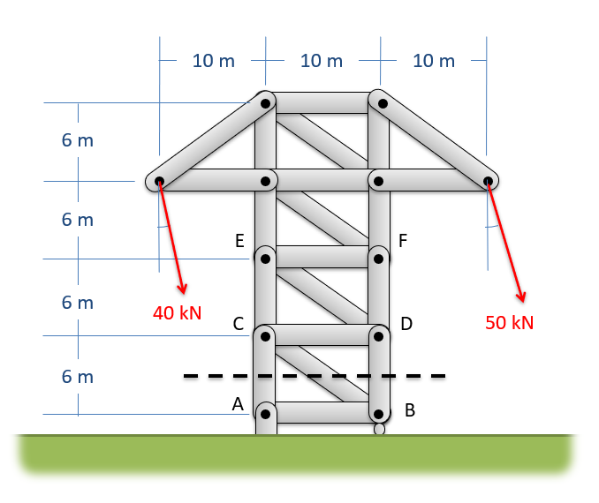
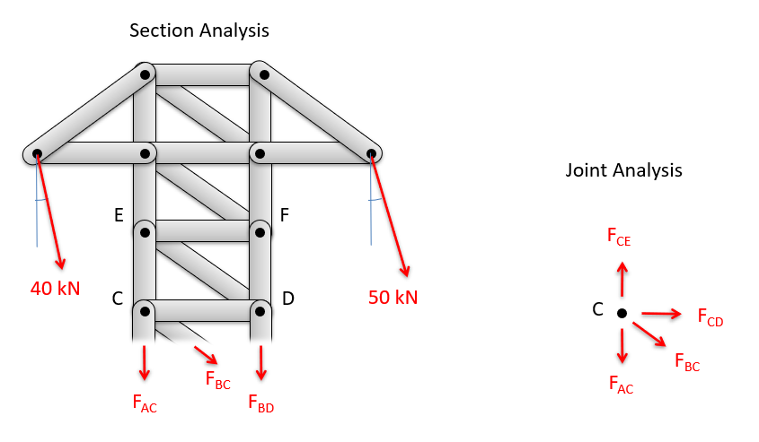

Slide 18
Thanks for Watching
See other engineering mechanics videos and access the full tool at…

Slide 19
Method of Sections Worked Example
Use the method of sections to find the forces in members BD and CE.
80 kN
60 kN
10 m
10 m
10 m
Y
A
B
D
F
X
20°
C
E

Slide 20
Method of Sections Worked Example
Use the method of sections to find the forces acting in the members at the base of this truss (AC, BC, and BD).
10 m
10 m
10 m
6 m
6 m
15° x2
6 m
40 kN
C
D
50 kN
6 m
A
B

Slide 21
Method of Sections Worked Example
Use the method of sections to find the forces in members AB and DE.
12 kN
2 m
2 m
2 m
2 m
A
B
2 m
C
2 m
D
E

Slide 22
Method of Sections Worked Example
5 ft
5 ft
5 ft
Use the method of sections to find the forces in members AC, BC, CD, and CE.
B
A
5 ft
D
800 lbs
C
5 ft
F
E
5 ft
G
H

